Slide 1

-An introduction and getting started
Himadri Tank
M. Tech CE, BE IT
Notes:
<number>

Slide 2
Introduction
Python is a popular open source programming language.
It is used for both standalone programs and scripting applications in a wide variety of domains.
It is free, portable, powerful, and remarkably easy and fun to use.
Python is a general-purpose programming language and it is commonly defined as an object-oriented scripting language— OOP with an overall orientation toward scripting roles.
<number>
prepared by : Himadri Tank

Slide 3
Introduction
Python is classiﬁed as a scripting language.
  That it’s not compiled to create the machine-readable code.
  Python is also considered a high-level language,
    It takes care of a lot of the work involved in programming.
  Python is readable code and enhancing programmer productivity.
Python uses whitespace instead of {} used in other programming language for block of code.
  With Python, these code blocks are identiﬁed by different amounts of indentation.
prepared by : Himadri Tank
<number>

Slide 4

History of Python
Python was created in 1989 by Guido van Rossum who is big fan of Monty python’s Flying Circus
  Created as a scripting language for administrative tasks
  Based on All Basic Code (ABC) and Modula-3
  Originally implemented on UNIX
  Named after comic troupe Monty Python
prepared by : Himadri Tank
<number>

Slide 5
History of Python
In 1991 python 0.9.0 was published
In January of 1994 python 1.0 was released
  Functional programming tools
  In 1995, python 1.2 was released.
By version 1.4 python had several new features
  Keyword arguments, Built-in support for complex numbers, data-hiding.
In 2000, Python 2.0 was released.
  Introduced list comprehensions and garbage collection
In 2001, Python 2.2 was released.
  Included classes, making pythons object model purely Object-oriented.
prepared by : Himadri Tank
<number>

Slide 6
python can be used for
Systems Programming
GUIs
Rapid Prototyping
Internet Scripting
Component Integration
Numeric and Scientific Programming
Database Programming
prepared by : Himadri Tank
<number>

Slide 7
python can be used for
Systems Programming
Python’s built-in interfaces to operating-system services for writing portable, maintainable system-administration tools and utilities (shell)
GUIs
Python’s simplicity and rapid turnaround supports graphical user interface programming.
Rapid Prototyping
To Python programs, components written in Python and C look the same. Because of this, it’s possible to prototype systems in Python initially, and then move selected components to a compiled language such as C or C++ for delivery.
prepared by : Himadri Tank
<number>

Slide 8
python can be used for
Internet Scripting
Python comes with standard Internet modules that allow Python programs to perform a wide variety of networking tasks, in client and server modes.
Component Integration
Python’s ability to be extended by and embedded in C and C++ systems makes it useful as a flexible glue language for scripting the behavior of other systems and components.
prepared by : Himadri Tank
<number>

Slide 9
python can be used for
Numeric and Scientific Programming
Python has a sophisticated easy-to-use numeric programming tool that can often replace existing code written in traditional compiled languages such as FORTRAN or C++.
Database Programming
For traditional database demands, there are Python interfaces to all commonly used relational database systems—Sybase, Oracle, Informix, ODBC, MySQL, PostgreSQL,
prepared by : Himadri Tank
<number>

Slide 10
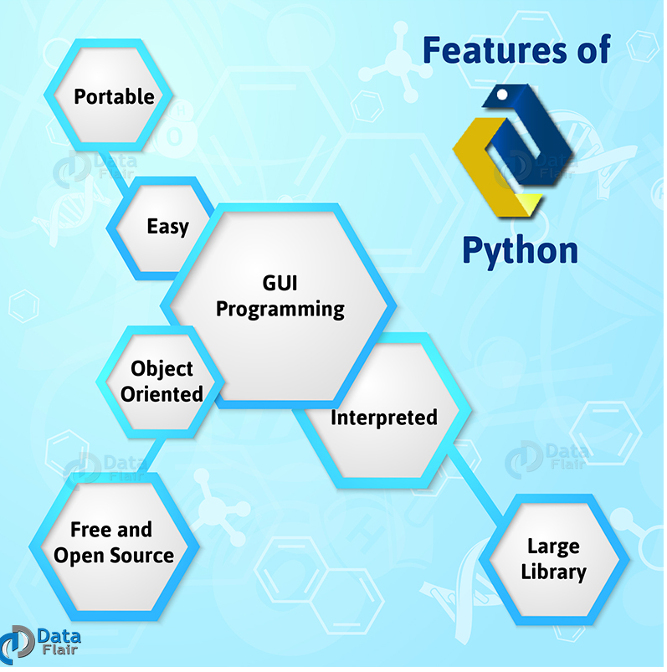
prepared by : Himadri Tank
<number>

Slide 11
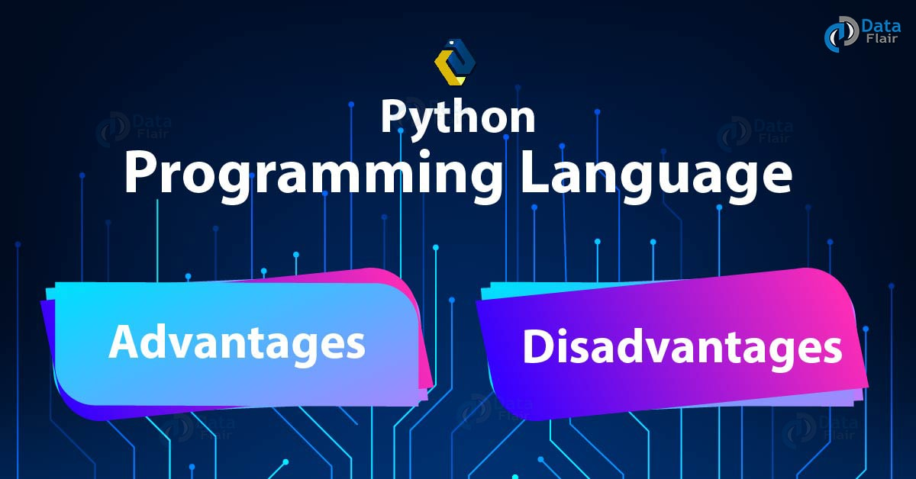
prepared by : Himadri Tank
<number>

Slide 12
Advantages of Python Programming Language
Object-Oriented
This language supports both the procedural and object-oriented programming paradigms
Free and Open-Source
Python is freely available. It downloads with an extensive collection of libraries to help you with your tasks.
Portable
you need to code only once, and you can run it anywhere. This is called Write Once Run Anywhere (WORA).
Interpreted
prepared by : Himadri Tank
<number>

Slide 13
Advantages of Python Programming Language
Improved Productivity
The language’s simplicity and extensive libraries render programmers more productive than languages like Java and C++ do.
IOT Opportunities
Since Python forms the basis of new platforms like Raspberry Pi, it finds the future bright for Internet Of Things.
Simple and Easy
Readable
Reading Python is much like reading English.
prepared by : Himadri Tank
<number>

Slide 14
Advantages of Python Programming Language
Extensive Libraries
These are the contain code for various purposes like regular expressions, documentation-generation, web browsers, threading, databases, CGI, email, image manipulation, and more.
Extensible
Python can be extended to other languages. You can write some of your code in languages like C++ or C.
Embeddable
Python is embed able as well. You can put your Python code in your source code of a different language, like C++. This lets us add scripting capabilities to our code in the other language.
prepared by : Himadri Tank
<number>

Slide 15
disadvantages of Python Programming Language
Speed Limitations
    Python is interpreted, it often results in slow execution.
Weak in Mobile Computing and Browsers
It is rarely ever used to implement smartphone-based applications.
Design Restrictions
  While this is easy on the programmers during coding, it can raise run-time errors.
  Underdeveloped Database Access Layers
  Compared to more widely used technologies like JDBC and ODBC ,Python’s database access layers are a bit underdeveloped.
  Simple
prepared by : Himadri Tank
<number>

Slide 16
Python Toolkit
Dynamic typing
Built-in object types
Built-in tools
Library utilities
Third-party utilities
Automatic memory management
Programming-in-the-large support
Notes:
<number>

Slide 17
Real world application - python
• Google makes extensive use of Python in its web search systems, and employs Python’s creator.
• The YouTube video sharing service is largely written in Python.
• The popular BitTorrent peer-to-peer file sharing system is a Python program.
• Google’s popular App Engine web development framework uses Python as its application language.
• ESRI uses Python as an end-user customization tool for its popular GIS mapping Products.
prepared by : Himadri Tank
<number>

Slide 18
Real world application - python
• Maya, a powerful integrated 3D modeling and animation system, provides a Python scripting API.
• Intel, Cisco, IBM use Python for hardware testing.
• Industrial Light & Magic, Pixar, and others use Python in the production of animated movies.
• JPMorgan Chase, UBS, Getco, and Citadel apply Python for financial market forecasting.
• NASA, Los Alamos, and others use Python for scientific programming tasks.
prepared by : Himadri Tank
<number>

Slide 19
Quiz
1. What are the six main reasons that people choose to use Python?
2. Name four notable companies or organizations using Python today.
3. Why might you not want to use Python in an application?
4. What can you do with Python?
prepared by : Himadri Tank
<number>

Slide 20
Installing Python for windows
  To install Python, you must first download the installation package of your preferred version from this link:
    https://www.python.org/downloads/
    Select latest python version and download
    Save python.exe in suitable path
    Run the python executable file
prepared by : Himadri Tank
<number>

Slide 21
Environment variables
PYTHONPATH
  It has a role similar to PATH.
PYTHONSTARTUP
  It contains the path of an initialization file containing Python source code.
PYTHONCASEOK
  It is used in Windows to instruct Python to find the first case-insensitive match in an import statement.
PYTHONHOME
  It is an alternative module search path.
prepared by : Himadri Tank
<number>

Slide 22
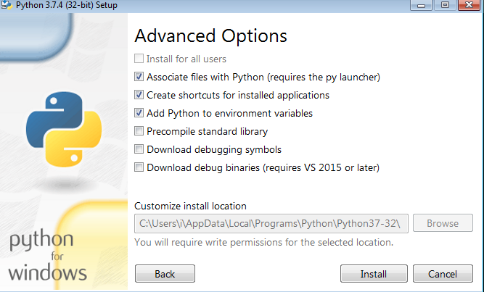
Environment variables
    This are the system varibles.
    To run a python program we need to add path of python executable path to “path” variable.
    Otherwise, run python executable file ->modify ->next->
    add python to environment variables
prepared by : Himadri Tank
<number>

Slide 23
Getting started
– executing python program
We can do python program through
    Python command line argument
    IDLE - (Integrated Development and Learning Environment)(Python’s Integrated Development Environment (IDE))
    Cmd
prepared by : Himadri Tank
<number>

Slide 24
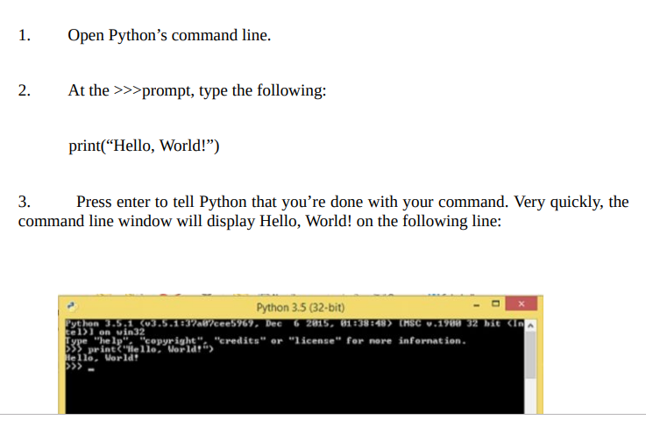
Executing python from the command line
prepared by : Himadri Tank
<number>

Slide 25
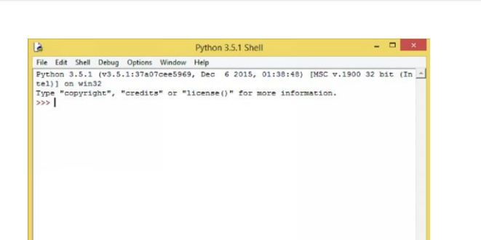
Executing python using idle
    The IDLE (Integrated Development and Learning Environment) tool is included in Python’s installation package
    The IDLE tool offers a more efficient platform to write your code and work interactively with Python
    You click on the IDLE icon, it will take you to the Python Shell window.
prepared by : Himadri Tank
<number>

Slide 26
Executing python using cmd
    Click on start
    Write cmd
    Set appropriate path for python file
prepared by : Himadri Tank
<number>

